Slide 1
FA565 Business Ethics and Corporate Governance
Week 5: Civil Society, Government & Regulation pt 1
Mark Elliot

Slide 2
Civil Society

Slide 3
Civil Society as ‘third sector’
State Sector
Government
Market Sector
Business
Civil Society Sector
Inc. NGOs, pressure groups, charities, unions…
Notes:
Civil Society can be seen as a counterbalance to the state and business, guarding against abuse of power and ensuring that people’s interests are served.

Slide 4
Civil Society Organisations
These include a whole plethora of pressure groups, non governmental organizations, charities, religious groups, and other actors that are neither business nor government organizations, but which are involved in the promotion of certain interests, causes, and/or goals.
In the US there are 1.5 million non-profit organizations, while in India there are approximately 2 million.

Slide 5
CSO Characteristics
Scope
Individual
Grass roots
Local
Regional
National
Transnational
Global
Type
Community group
Campaign group
Research organisation
Business association
Trade union
Technical body
Structure
Informal
Formal
Co-operative
Professional
Entrepreneurial
Network
Focus
Natural environment
Social issues
Development
Poverty alleviation
Activities
Human rights
Animal welfare
Research
Dialogue
Information provision
Service provision
Campaigning
Partnerships

Slide 6
Civil Society Organisations as Stakeholders
Different from other stakeholders of businesses as others generally contribute resources to the business.
The stake held by CSOs is indirect and representative and therefore is largely one of:
Representing the interests of individual stakeholders
Representing the interests of non-human stakeholders
CSOs form part of businesses’ social license to operate.

Slide 7
Ethical Issues of Civil Society Organisations
Many CSO groups tend to ‘self-declare’ themselves as stakeholders in a particular issue
Self-declaring does not necessarily lead to recognition
Ignoring CSOs may have detrimental long-term consequences

Slide 8
CSO Tactics
Indirect Action
Research & communication about issues of relevance
Violent Direct Action
Usually illegal, high publicity
Can be physical or virtual (e.g. DDoS attacks)
Non-Violent Direct Action
Campaigns and activism
Boycotts
Coordinated effort to avoid certain purchases in the marketplace

Slide 9
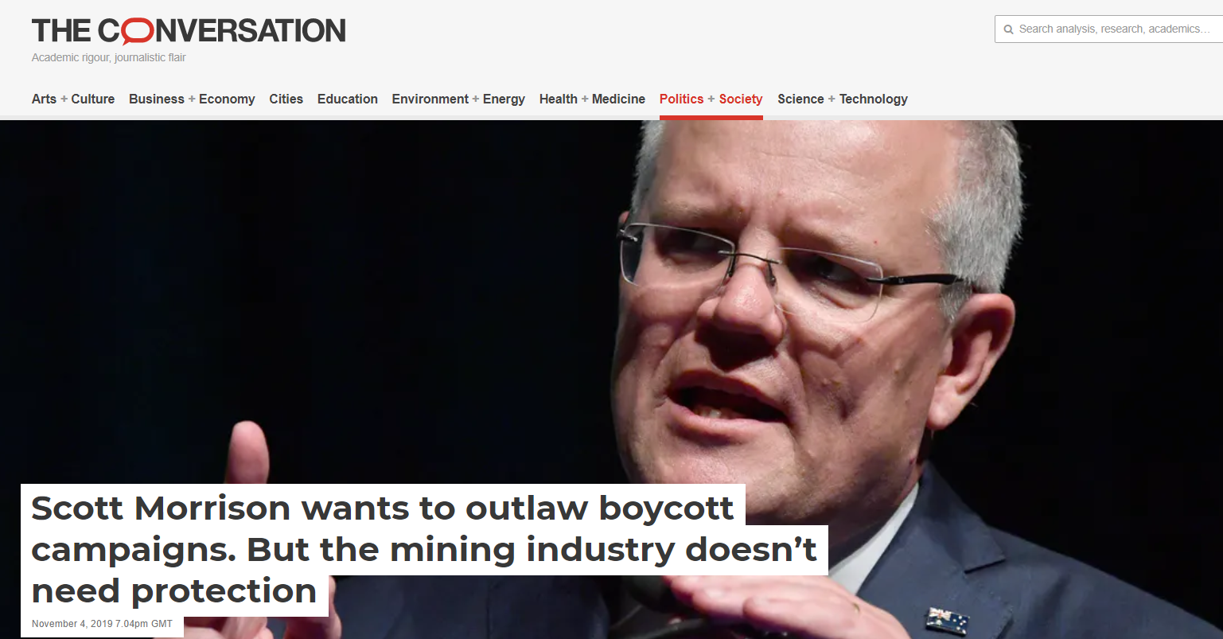
Regulations on boycotts
Read more: The Conversation, 04/11/2019, available at:
https://theconversation.com/scott-morrison-wants-to-outlaw-boycott-campaigns-but-the-mining-industry-doesnt-need-protection-126326
(Australian) Prime Minister Scott Morrison vowed to craft new laws targeting social and political protest. Speaking to the Queensland Resources Council, he labelled some activist groups as environmental “anarchists”, and lamented how businesses like banks might be sensitive to consumer or protest group pressure to limit dealings with the mining industry.

Slide 10
CSO Accountability - Stakeholders
Beneficiaries
Donors
Members
Employees
Governmental organizations
Other CSOs
General public

Slide 11
CSO Accountability
Recently, growing number of organizations similar to CSOs being initiated within business
Accountability of CSOs to supposed beneficiaries tends to raise most debate
Force agendas on beneficiaries without understanding needs
Limited involvement of beneficiaries in decision making
CSO donor interests receive higher priority
Lack of effective mechanisms for beneficiaries to feed back on CSO performance

Slide 12
‘Global Standard for CSO Accountability’
1. Justice & Equality
2. Women’s Rights & Gender Equality
3. Healthy Planet
4. Lasting Positive Change
5. People-Driven Work
6. Strong Partnerships
7. Advocating for Fundamental Change
8. Open Organisations
9. Empowered, Effective Staff & Volunteers
10. Well-handled Resources
11. Responsive Decision-making
12. Responsible Leadership
https://accountablenow.org/wp-content/uploads/2022/06/12Commitments_Booklet-1.pdf

Slide 13
Globalisation and Civil Society Organisations
Globalization reshaping relations between corporations and CSOs:
Engagement with overseas CSOs
Global issues (e.g. climate change, water conservation, human rights) and causes
Global civil society

Slide 14
Businesses & CSOs working together
Charity and community involvement
Making a meaningful social contribution
Contributing to the development of their human resources
Enhancing the firm’s reputation
Increasing employee morale
Building ‘social capital’ within the community
Business-CSO collaboration (social partnerships)
Closer and more interactive relations between civil society and corporations
Difficulties: managing culturally diverse organisations, ensuring consistency and commitment.
However – CSO independence is key!

Slide 15
Civil Regulation
Civil regulation is the ability and power of CSOs to shape, influence or curb business practice
Focus on relations and outcomes
Key drawback is that regulation is voluntary
Key points
Civil society can act as a conduit through which individuals citizens can exert some kind of leverage on, or gain a form of participation in, corporate decision-making and action
CSOs are now part of systems or regimes of ‘global governance’

Slide 16
Civil Society, Business, and Sustainability
Balancing competing interests
Civil society: wide variety of disparate actors promoting different issues
Business must take account of these different issues simultaneously
Fostering participation and democracy

Slide 17
Government & Regulation

Slide 18
Government as a Stakeholder of Business
Government as a stakeholder of business
Government as the elected representative of citizens’ interests
Restricting business
Enabling business
Government as an actor (or group of actors) with interests of its own
Dependent on business
Competing with business

Slide 19
Government as a representative of citizens’ interests
Unlike many other stakeholders, government in principle represents an entire community since it is elected by the citizens of a certain town, region, country or even continent
In this role as the elected representative of citizens’ interests:
Defines the conditions for the licence to operate of business
Restricting business
Enabling business
Debate about the degree of governmental responsibility for a functioning economy
Laissez-faire vs. forceful role in industrial policy

Slide 20
Government as an actor (or group of actors) with interests of its own
Governments have a self-interest to be re-elected
Governments very dependent on business
Governments also compete with business

Slide 21
Identifying the basic problems and issues: legitimacy, accountability and modes of influence
Main source of ethical problems stems from fiduciary relation to society in general
Government therefore being pulled in two directions
Taxes, jobs, investment, etc.
Regulation that protects their interests
Business
Government
Society
Profitable and stable economic framework
Consent

Slide 22
Legitimacy of Business Influence
Corporate political activity: Any business effort to influence government or public policy, including activities such as lobbying, political advertising, financial contributions, legal action and political campaigning.
Business can have a significant influence on the implementation and direction of governmental policies. It is therefore to no surprise that the issue of ‘public sector ethics’ has gained enormous momentum (Dobel, 2007). The main ethical consideration arising from this situation is twofold
Legitimacy of business influence;
Accountability.

Slide 23
Accountability to the public
One may contend that since the government acts as a representative of society’s interests, the public has a right to be informed about governmental decisions with other constituencies (such as business), and be able to determine whether it is acting in its interests or not
Although both parties are able to influence each other, the main concerns for business ethics are where business has influence on government

Slide 24
Methods of Influence
Lobbying
Individual conflicts of interests
Party and campaign financing
Corruption
Notes:
Lobbying - Influence through provision of persuasive information
Party and campaign financing – Influence through financial means e.g. donations, e.g. Conservative Party & fossil fuel industry
Individual conflicts of interest - Tendency of people to move between politics and business, e.g. Trump
Corruption – Payment of bribes to politician or other illegal actions – see Transparency International, ‘Corruption Perception Index’

Slide 25
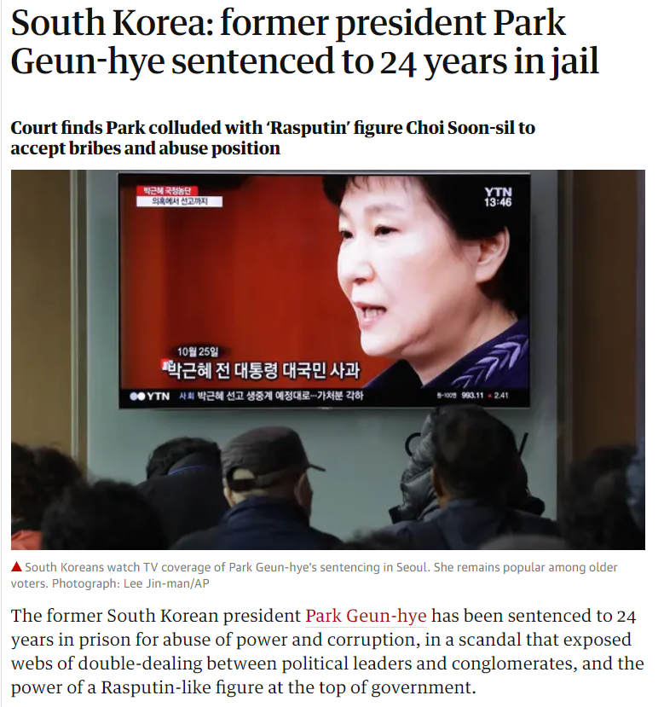
Former president of South Korea jailed
Read more at:
https://www.theguardian.com/world/2018/apr/06/former-south-korea-president-park-geun-hye-guilty-of-corruption

Slide 26
Ethical issues in the context of privatisation and deregulation
Privatisation profits
Key issue is a fair price
Citizens turned consumers
Economic basis for decisions, rather than political
E.g. Postal services
Natural monopolies
Can lead to over-charging or delivering poor quality
E.g. Railways
PPPs (Public-Private Partnerships)
Private sector profit-maximization tends to dominate at the expense of quality and effectiveness for citizens
E.g. UK – Healthcare sector

Slide 27
Globalisation
When globalisation deterritorializes social, economic, and political action, the significance of these nation states is weakened.
On a global level, corporations assume a more dominant role while governments – bound by their confinement to territorial boundaries – have only limited influence beyond national boundaries
Business-government relations in international trade regimes
Global players: WTO or World Bank
Regional bodies: EU, NAFTA, ASEAN

Slide 28
Business as key player in the regulatory game
Debate over how to improve rulemaking
Self-regulation
Collective agreements by sectors of industry
Certification by International Standards Organisation, e.g. ISO 14000s (Environmental Management) and ISO 26000s (Social Responsibility)

Slide 29
Government and Corporate Sustainability
The debate on climate change regulation has been a key political arena of sustainability
CO₂ reductions represent a big threat for some industries
In Australia, Canada, USA, lobbying was against action
Global supply of food and water is another key issue
Bolivian example of ethical issues in water privatization

